Slide 1
Empowering independence with ai-enhanced applications

Slide 2
Problem statement : mobile application solutions for healthcare,payer,and insurance

Slide 3
TEAM NAME:TECH ARMY TEAM members: e.g.Pradeep m.s.saisankeeth g.suriayaa b.prasanth v.kouciakan

Slide 4
FEATURES OF HEALTHCARE APPLICATIONS: TELEMEDICINE: ALLOWS PATIENTS TO CONNECT WITH DOCTORS AND OTHERS HEALTHCARE PROFESSIONALS FOR VIRTUAL CONSULTATIONS. HEALTH MONITORING: ALLOWS HEALTHCare providers to access patient data,monitor their health in real time,and make informed decisions. Wearable devices: allow users to gauge fluctuations in their spo2 level,blood pressure,etc..,on aregular basis. Blockchain: can be used for managing emr and ehr data, conducting research,medicine tracking and bettering the insurance and hospital billing process.

Slide 5
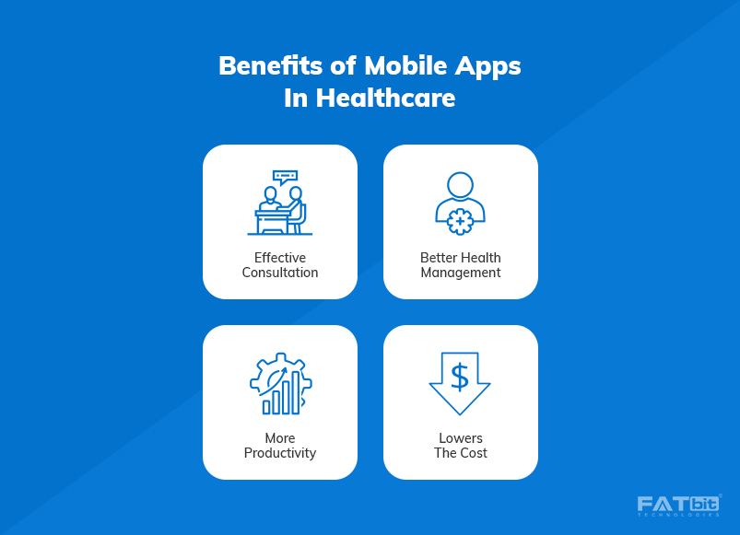
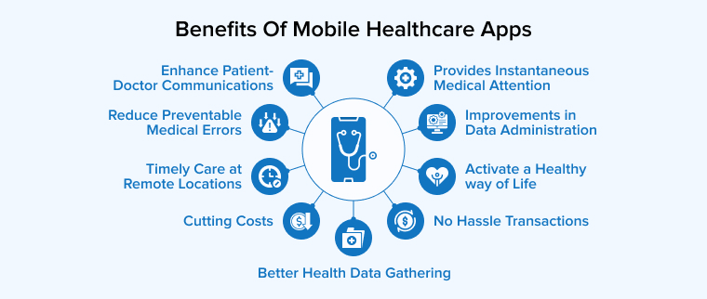
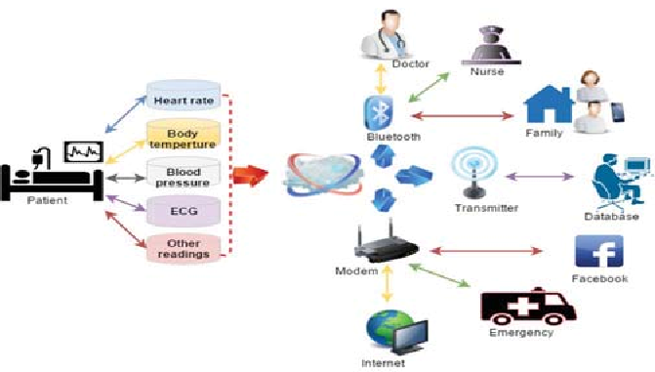


Slide 6
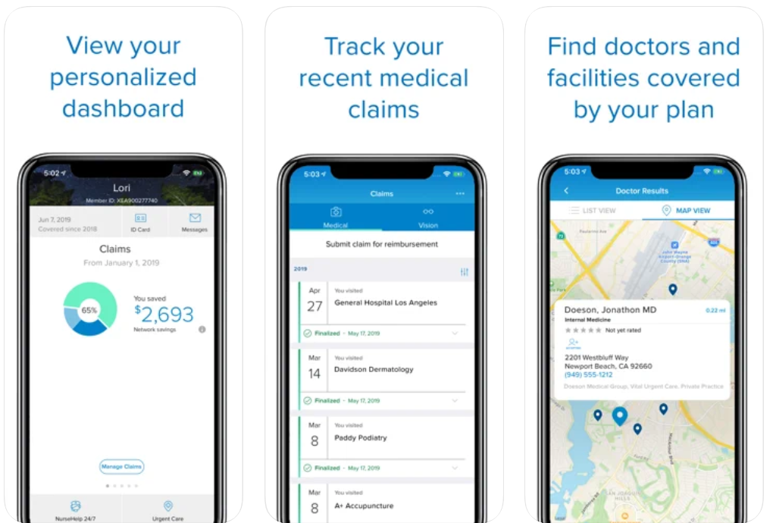
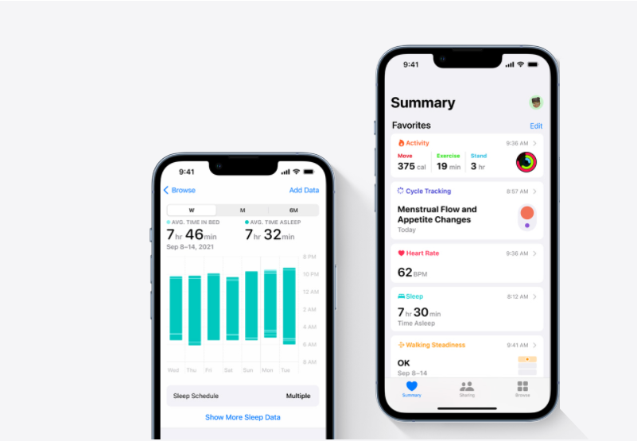
Exsiting model:

Slide 7
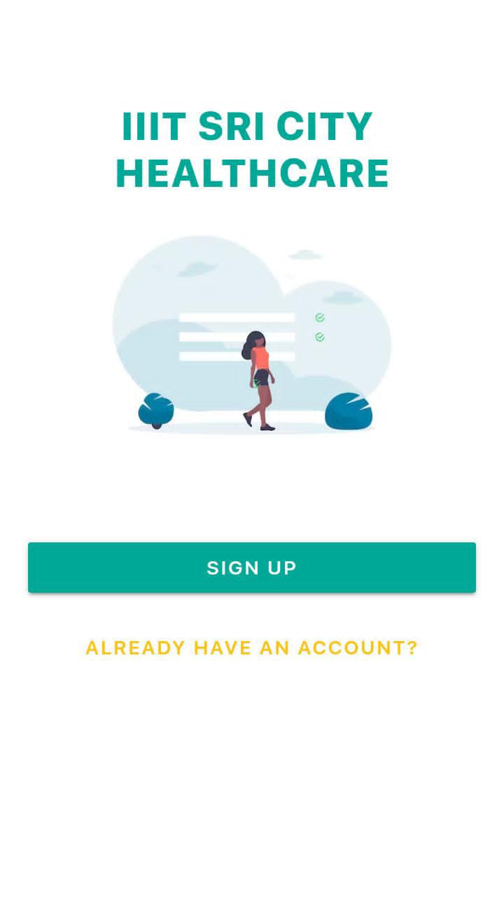
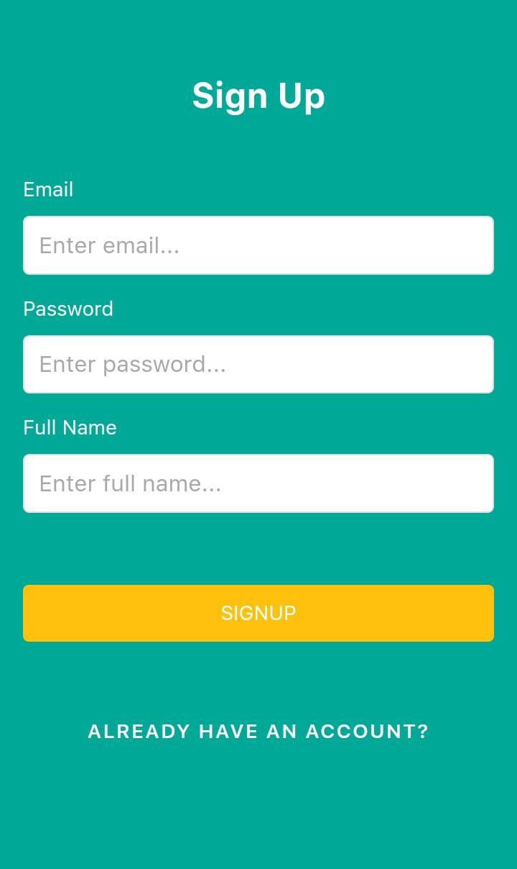
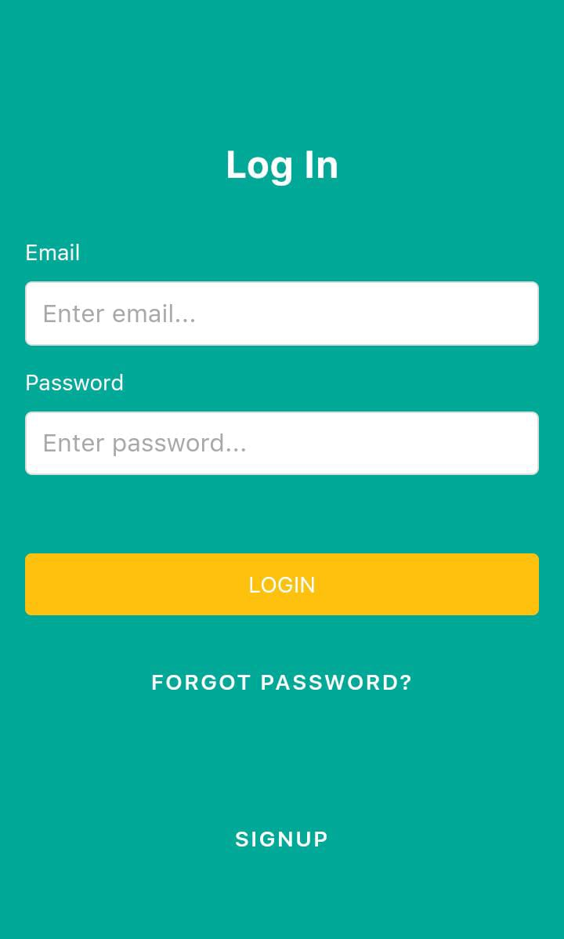
Our model:

Slide 8
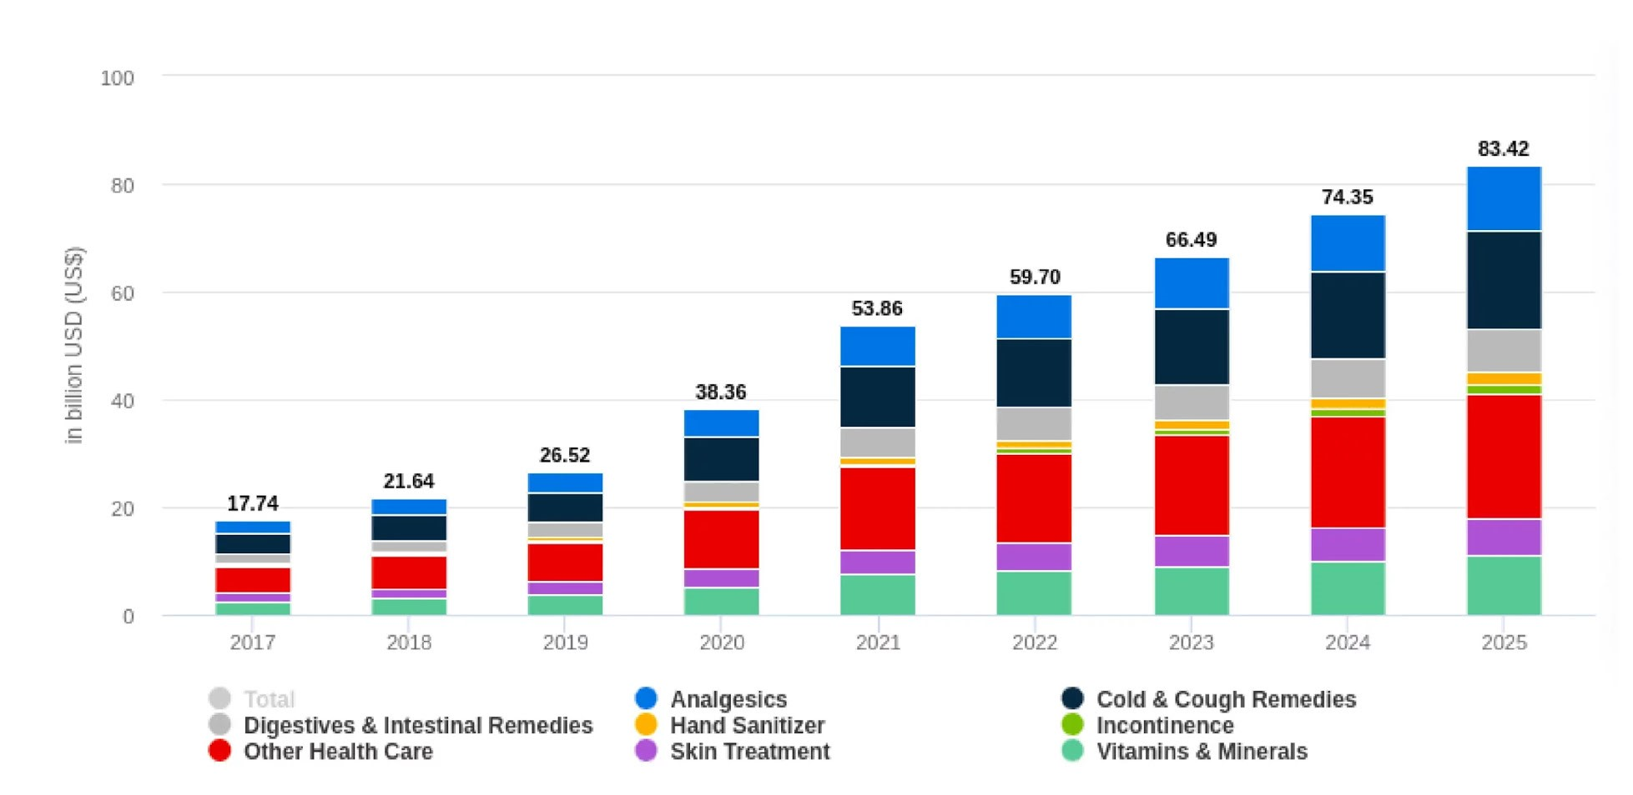
Guide to develop mobile healthcare APPLICATIONS

Slide 9
The healthcare industry has grown rapidly in recent years, particularly after the COVID-19 pandemic. According to Statista, revenue in the global healthcare market is estimated to grow to $57.86 billion in 2023, growing at a CAGR of 10.40% from 2023-2027, resulting in a market volume of $85.95 billion by 2027. This growth is driven by the fact that an increasing number of medical organizations are opting for healthcare mobile app development to improve the overall quality of medical services. The primary reasons for the escalating adoption of healthcare IT consulting services include: Ease of healthcare access Digital transformation in the healthcare industry: Higher access to healthcare users Better health tracking and monitoring Easier and faster delivery of medical services Early detection of potential ailments and so on Owing to the above reasons, mobile healthcare apps, also known as mHealth apps, are an exceptional way to make the lives of patients and doctors easier, thus improving overall patient care. While MOBILE Health app development is a proven way to improve patient care and satisfaction, 8 out of 10 healthcare apps fail to meet users’ expectations due to reasons such as the lack of strategy, technical guidance, meaningful impact to cover medical challenges, etc. Well, to help you in your healthcare software application development journey, here is a comprehensive guide that will give you a good insight into medical app development best practices, processes, types, benefits, costs, and so on. So, without further ado, let’s jump right in and uncover the essential details revolving around Health app development. But before we start, here are quick insights into the current healthcare market landscape.

Slide 10
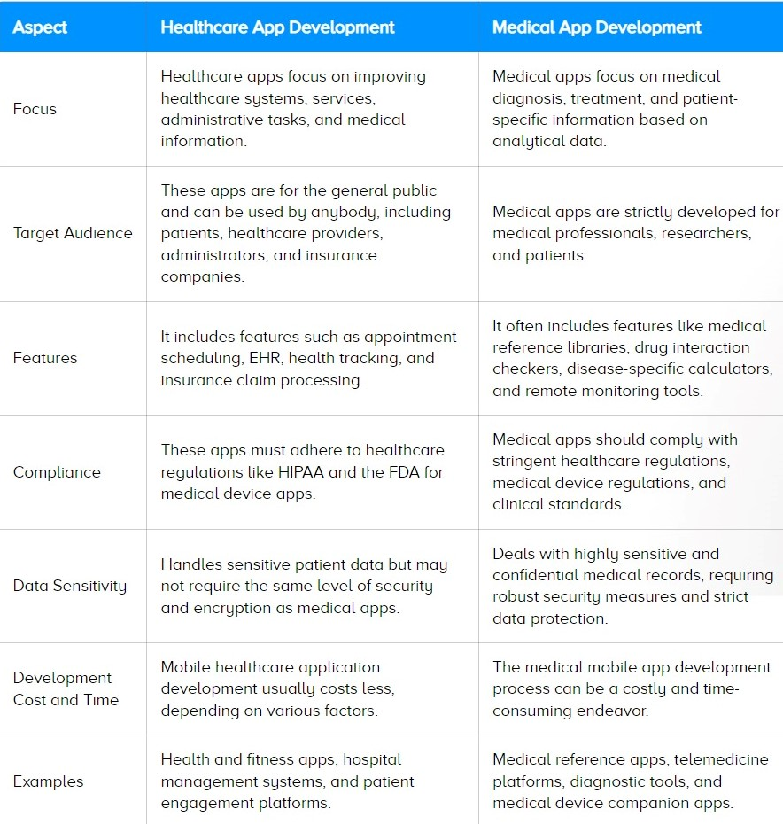

Slide 11
Thank you

